Slide 1
Presentation brief for MCT’s
Title of presentation | Azure for the Data Engineer.
Presentation\Lab length | Presentation: 40 - 45 minutes. Lab: 50 – 60 minutes
Audience | Data Professionals, Data Architects, Business Intelligence Professionals, Developers.
Purpose | Introduce data engineering from the perspective of the types of data, technologies, roles and responsibilities. Understand the Case Study that will be used as the basis for all of the labs.
(think) Student key takeaways | The student should understand how data has evolved into many types of structured, semi-structured and non-structured. The student should have an appreciation of the different data platform technologies at a high level. The student should be able to understand the key roles and responsibilities of a data engineer.
(feel) Student desired mindset | The student should understand why data engineering extends the skillset of a DBA to new technologies and tasks. The student should feel that this is overwhelming, but learn that this course provides a broad overview of key skills required.
(do) Student outcomes | The student should be able to give examples of how data has changed. The student should be able to articulate a one sentence description of each data platform technology. The students should be able to describe the Adventureworks Case Study.
More information | For MCT course feedback, visit the Microsoft Official Courseware forum

Slide 2

DP-200T01: Azure for the Data Engineer

Slide 3
Agenda
L01 – Explain the evolving world of data
L02 - Survey the services in the Azure Data Platform
L03 - Identify the tasks that are performed by a Data Engineer
L04 - Describe the use cases for the cloud in a Case Study

Slide 4










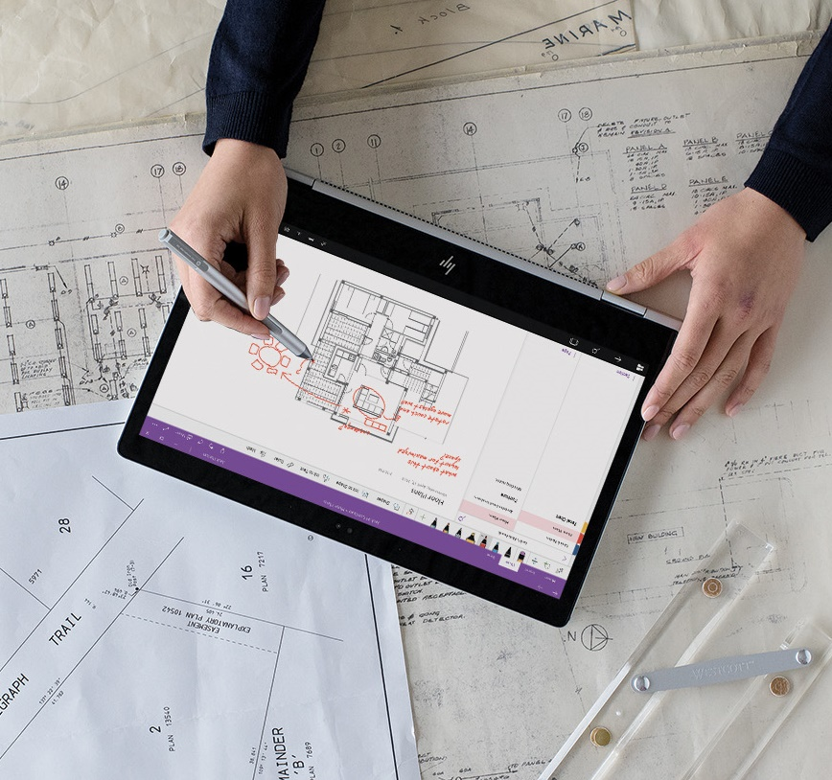


Lesson 01
The Evolving World of Data
Data
Cloud
AI

Slide 5
Lesson Objectives
Data Abundance
Differences between on-premises and cloud data technologies
How the role of the data professional is changing in organizations
Identify use cases impacted by these changes

Slide 6
Processes | Businesses are tasked to store, interpret, manage, transform, process, aggregate and report on data
Consumers | There are a wider range of consumers using different types of devices to consume or generate data.
Variety | There’s a wider variety of data types that need to be processed and stored
Responsibilities | A data engineers role is responsible for more data types and technologies.
Technologies | Microsoft Azure provides a wide set of tools and technologies
Data Abundance

Slide 7


On-premises versus cloud technologies
Computing Environment
Licensing Model
Maintainability
Scalability
Availability
Notes:
In this slide only 5 factors have been shown, highlight to the students that there are other factors as shown in the courseware

Slide 8

Data Engineering Job Responsibilities
New skills for new platforms
Changing loading approaches
From implementing to provisioning
8

Slide 9
Use Cases for the Cloud
Here are some examples of industries making use of the cloud
Web Retail
Using Azure Cosmos DB's multi-master replication model along with Microsoft's performance commitments, Data Engineers can implement a data architecture to support web and mobile applications that achieve less than a 10-ms response time anywhere in the world
Healthcare
Azure Databricks can be used to accelerate big data analytics and artificial intelligence (AI) solutions. Within the healthcare industry, it can be used to perform genome studies or pharmacy sales forecasting at petabyte scale
IoT Scenarios
Hundreds of thousands of devices have been designed and sold to generate sensor data known as Internet of Things (IoT) devices. Using technologies like Azure IoT Hub, Data Engineers can easily design a data solution architecture that captures real-time data.

Slide 10
Review Questions
Q01 – What data processing framework will be mainly used by Data Engineers to ingest data into cloud data platforms on Azure?
A01 – Extract, Load and Transform (ELT)
Q02 - What type of data can have its own schema at defined at query time?
A02 – Un-structured data
Q03 - Duplicating customers content for redundancy and meeting Service Level Agreements in Azure meets which cloud technical requirement?
A03 – High Availability

Slide 11
Lesson 02
Survey the Services in
the Azure Data Platform
Data
Cloud
AI

Slide 12
Lesson Objectives
The differences between structured and non-structured data
Azure Storage
Azure Data Lake Storage
Azure Databricks
Azure Cosmos DB
Azure SQL Database
Azure SQL Data Warehouse
Azure Stream Analytics
Additional Azure Data Platform Services
Notes:
It is important to stress to the students that this is an overview of the data platform capability, as a result multiple topics are on a single slide to aid in brevity.

Slide 13
Structured versus non-structured data
There are three broad types of data and Microsoft Azure provides many data platform technologies to meet the needs of the wide varieties of data
Structured
Semi- Structured
Unstructured
Structured data is data that adheres to a schema, so all of the data has the same fields or properties. Structured data can be stored in a database table with rows and columns.
Semi-structured data doesn't fit neatly into tables, rows, and columns. Instead, semi-structured data uses _tags_ or _keys_ that organize and provide a hierarchy for the data.
Unstructured data encompasses data that has no designated structure to it. Known as No-SQL., there are four types of No-SQL databases:
Key Value Store
Document Database
Graph Databases
Column Base

Slide 14


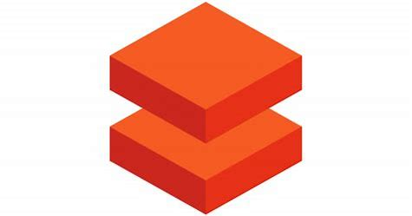



What to use for Data
Module 02
When you need a low cost, high throughput data store.
When you need to store No-SQL data.
When you do not need to query the data directly. No ad hoc query support.
Suits the storage of archive or relatively static data.
Suits acting as a HDInsight Hadoop data store.
Module 02
When you need a low cost, high throughput data store.
Unlimited storage for No-SQL data
When you do not need to query the data directly. No ad hoc query support.
Suits the storage of archive or relatively static data.
Suits acting as a Databricks , HDInsight and IoT data store.
Eases the deployment of a Spark based cluster.
Enables the fastest processing of Machine Learning solutions.
Enables collaboration between data engineers and data scientists.
Provides tight enterprise security integration with Azure Active Directory
Integration with other Azure Services and Power BI.
Module 03
Provides global distribution for both structured and unstructured data stores.
Millisecond query response time.
99.999% availability of data.
Worldwide elastic scale of both the storage and throughput
Multiple consistency levels to control data integrity with concurrency
Module 04
When you require a relational data store.
When you need to manage transactional workloads
When you need to manage a high volume on inserts and reads
When you need a service that requires high concurrency
When you require a solution that can scale elastically
Module 05
When you require a relational data store.
When you need to manage analytical workloads
When you need low cost storage.
When you require the ability to pause and restart the compute.
When you require a solution that can scale elastically
Module 05
Notes:
Note: This is a build slide for multiple topics by design.
It is important to stress to the students that this is an overview of the data platform capability, as a result multiple topics are on a single slide to aid in brevity

Slide 15




What to use for Data
Module 06
When you require a fully managed event processing engine.
When you require temporal analysis of streaming data.
Support for analyzing IoT streaming data.
Support for analyzing application data through Event Hubs.
Ease of use with a Stream Analytics Query Language.
Module 07
When you want to orchestrate the batch movement of data.
When you want to connect to wide range of data platforms.
When you want to transform or enrich the data in movement.
When you want to integrate with SSIS packages.
Enables verbose logging of data processing activities.
When you need a low cost, high throughput data store.
When you need to store No-SQL data.
Provides a Hadoop Platform as a Service approach
Suits acting as a Hadoop, Hbase, Storm or Kafka data store.
Eases the deployment and management of clusters.
When you require documentation of your data stores.
When you require a multi user approach to documentation.
When you need to annotate data sources with descriptive metadata.
A fully managed cloud service whose users can discover the data sources.
When you require a solution that can help business users understand their data.
Notes:
Note: This is a build slide for multiple topics by design.
It is important to stress to the students that this is an overview of the data platform capability, as a result multiple topics are on a single slide to aid in brevity.
HDIsight is not covered on this course as there are other courses that cover this. Azure Data Catalog is not on this course as it is not part of the exam objectives and it is a easy technology to learn.

Slide 16
Review Questions
Q01 - What data platform technology is a globally distributed, multi-model database that can offer sub second query performance?
A01 – Azure Cosmos DB
Q02 - Which of the following is the cheapest data store to use when you want to store data without the need to query it?
A02 – Azure Storage Account
Q03 - Which Azure Service would be used to store documentation about a data source?
A03 – Azure Data Catalog

Slide 17
Lesson 03
Identify the Tasks
Performed by a Data Engineer
Data
Cloud
AI

Slide 18
Lesson Objectives
List the new roles of modern data projects
Outline Data Engineering Practices
Explore the high-level process for architecting a data engineering project

Slide 19
Roles in Data Projects
Data Engineer
AI
Engineer
Data
Scientist
19

Slide 20

Data Engineering Practices
Provision
Process
Secure
Monitor
Disaster
Recovery
Notes:
The content describes the changing nature of data processing from ETL to ELT, and how a data engineer has to look at the whole data architecture process holistically, within this

Slide 21
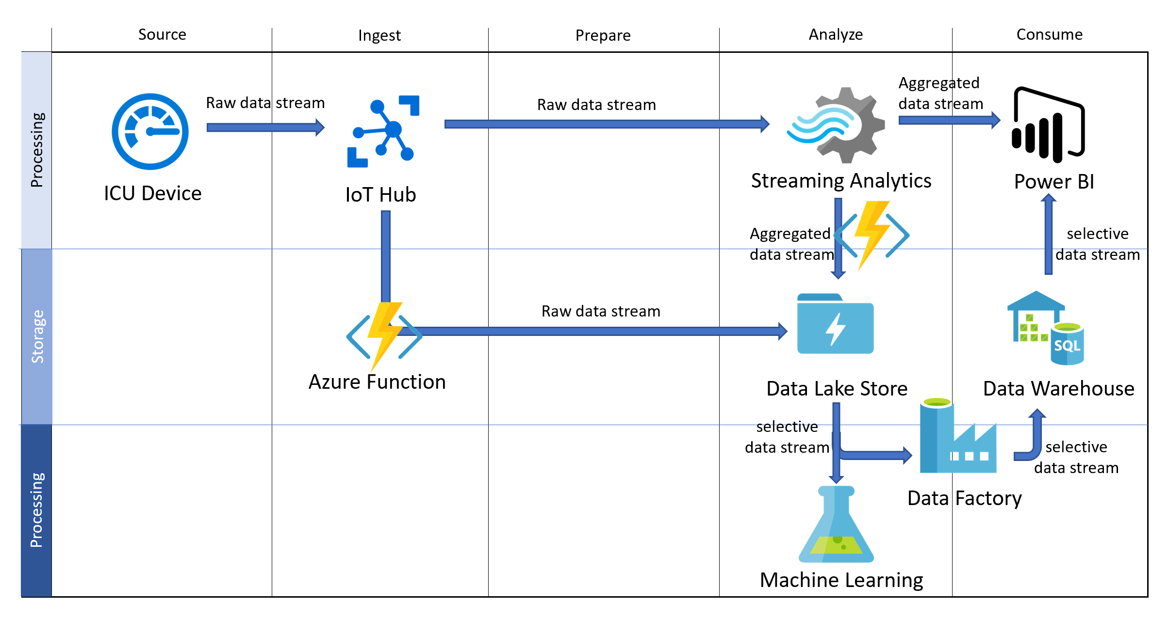
Architecting Projects – an example.

Slide 22
Review Questions
Q01 – Which role works with services such as Cognitive Services, Cognitive Search, and the Bot Framework
A01 – AI Engineer
Q02 - Which Azure Data Platform technology is commonly used to process data in an ELT framework?
A02 – Azure Data Factory

Slide 23
Lesson 04
Course Case Study
Data
Cloud
AI

Slide 24
Lesson Objectives
Read the Course Case Study

Slide 25

Course Case Study AdventureWorks Cycles
Read the case study
In this section of the course, the instructor will either:
Allocate you 10 minutes to read through the case study.
Or
Spend 10 minutes walking through the case study with you as a group
Note:
This case study will be used in labs across the entire course. Each lab will drill down more into the detail of what is required as you perform each lab.
Notes:
You should point out to the students that this case study is designed to cover a scenario in other courses in the AI Engineering and Data Science disciplines as well. It is likely that not all of the case studies requirements will be delivered in all of the labs in this course.

Slide 26
Review Questions
Q01 – Which requirement is likely to be the easiest to implement from a data engineering perspective?
A01 – AdventureWorks Website
Q02 - Which data platform technology could be used to implement the predictive analytics capabilities that AdventureWorks desires?
A02 – Azure Databricks
Q03 - Which data platform technology could be used to help AdventureWorks scale globally?
A03 – Azure Cosmos DB

Slide 27

Lab: Azure for the Data Engineer

Slide 28
Lab overview
The students will take the information gained in the lessons and from the case study to scope out the deliverables for a digital transformation project within AdventureWorks. They will first identify how the evolving use of data has presented new opportunities for the organization. The students will also explore which Azure Data Platform services can be used to address the business needs and define the tasks that will be performed by the data engineer. Finally, students will finalize the data engineering deliverables for AdventureWorks.
Lab objectives
After completing this lab, you will be able to:
1. Identify the evolving world of data within AdventureWorks.
2. Determine the Azure Data Platform services to use for AdventureWorks.
3. Identify the tasks to be performed by the Data Engineer.
4. Finalize the data engineering deliverables for AdventureWorks.

Slide 29
Lab scenario
You have been hired as a Senior Data Engineer to advise the management and employees of AdventureWorks on a digital transformation project. AdventureWorks has been selling bicycles and bicycle parts directly to end-consumer and distributors for over a decade. In the last few years, they have observed how different industries have been taking advantage of recent developments in cloud technology to offer customers a more personalized and engaging service. They want to lead the way in their industry.
You have been asked to work with the IT department to perform a discovery workshop with the organization to identify which data platform technologies can be used to the benefit of both AdventureWorks and their customers. They are specifically wanting to make sure that the technology brings the business closer to their customers on a variety of levels. This can include making personalized offers when making purchases or using customer services, to offering telemetry information on the bikes that they use. There is also a requirement to manage an existing reporting system that is held in a data warehouse.
The first step is to assess the current state of the cloud technologies and make sure that they can perform the project by performing the following analysis:
1. Identify the evolving world of data within AdventureWorks
2. Determine the Azure Data Platform services to use for AdventureWorks
3. Identify the tasks to be performed by the Data Engineer
4. Finalize the data engineering deliverables for AdventureWorks

Slide 30
Lab review
Exercise 1 – Have any data requirements been missed?
Exercise 2 – Was there any debate in the mapping of a technology against a given data requirement?
Exercise 3 – Are there any additional tasks that you think a Data Engineer should perform?
Exercise 4 – Which particular technologies do you want to focus on in this course?

Slide 31

Next steps
Module Summary
In this module, you have learned about:
- The evolving world of data.
- The services in the Azure Data Platform.
- The tasks that are performed by a Data Engineer.
- A fictitious Case Study for use in labs.
After the course, consider visiting [the Microsoft Customer Case Study site. Use the search bar to search by an industry such as healthcare or retail, or by a technology such as Azure Cosmos DB or Stream Analytics. Read through some of the customers stories.

